Slide 1
Home Run Slides:
Prediabetes Prevalence among High-Risk Groups in Maine
Updated: 10/18/2017

Slide 2
Prevalence of Prediabetes and Diabetes in Maine
Source: U.S. Centers for Disease Control and Prevention, Behavioral Risk Factor Surveillance System (BRFSS), 2015.
Among Maine adults, 10% reported having been diagnosed with diabetes and 7% reported having been diagnosed with prediabetes.
Though 83% of Mainers are non-diabetic, this percentage includes adults with undiagnosed diabetes or prediabetes.

Slide 3
Overweight or obese adults are the largest group at high risk for Type 2 diabetes at 66.5% of Maine adults.*
High-Risk Groups for Type 2 Diabetes by Cardiovascular Disease Risk Factors and Outcomes
Risk Factors
Source: U.S. Centers for Disease Control and Prevention (CDC), Behavioral Risk Factor Surveillance System (BRFSS), 2015.
*Data based on self-report of selected risk factor or cardiovascular disease outcome on BRFSS.
**Non-adherence to current CDC-recommended aerobic guidelines.
Outcomes
Prevalence (%)

Slide 4
Undiagnosed Diabetes in the U.S
Nationally, 30.3 million people (9.4% of U.S. population) have diabetes.
Nearly a quarter (23.8%) of Americans with diabetes remain undiagnosed.
The true diabetes prevalence among Maine adults could be close to 12.5%.
  We estimate that 101,400 Maine adults have diagnosed diabetes.
  If 23.8% of all Maine adults with diabetes are undiagnosed, then there are an estimated 31,700 Maine adults with undiagnosed diabetes.
Source: U.S. CDC National Center for Chronic Disease Prevention and Health Promotion, Division of Diabetes Translation. National Diabetes Statistics Report, 2017. Available at: https://www.cdc.gov/diabetes/pdfs/data/statistics/national-diabetes-statistics-report.pdf

Slide 5
Prevalence of Diagnosed Prediabetes among High-Risk Groups for Type 2 Diabetes
Prevalence of Diagnosed Prediabetes
High-Risk Group | %
Heart Attack History | 15.8
Coronary Heart Disease History | 15.6
High Blood Pressure | 12.8
High Cholesterol | 12.3
Stroke History | 11.4
Overweight or obese | 10.2
Physically Inactive* | 9.5
Racial/Ethnic Minority | 5.7
Source: U.S. Centers for Disease Control and Prevention, Behavioral Risk Factor Surveillance System (BRFSS),Maine 2013 & 2014.
*Data based on self-report of selected risk factor or cardiovascular disease outcome on BRFSS.
All data from 2014, except for high cholesterol, high blood pressure, and physical inactivity which are from 2013.
*Physical inactivity defined by CDC-recommended aerobic guidelines.
Prevalence of diagnosed prediabetes is highest among Mainers with a prior cardiovascular disease diagnosis.

Slide 6
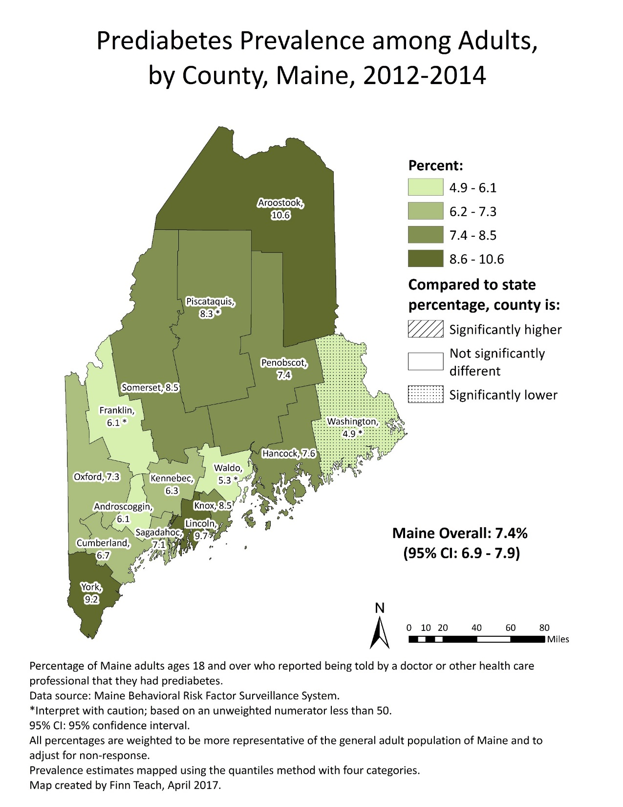

Slide 7
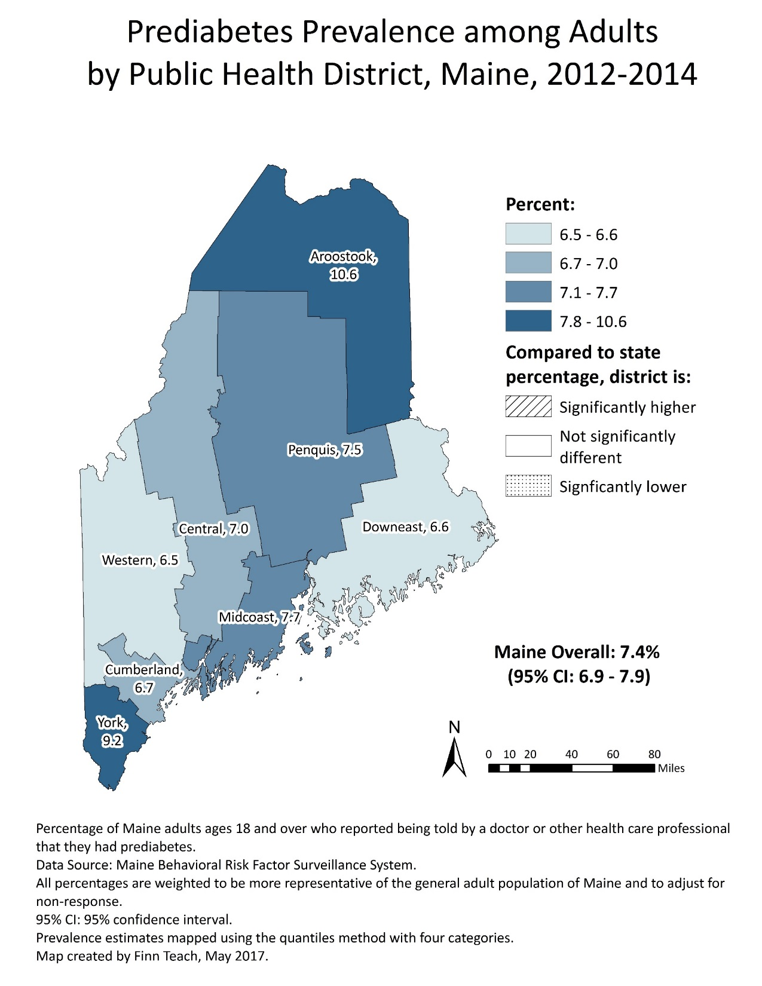

Slide 8
Diabetes Testing Guidelines
The US Preventive Services Task Force (USPSTF) recommends screening for type 2 diabetes in asymptomatic adults aged 40 to 70 years who are overweight or obese.
Clinicians should consider earlier screening in persons with 1 or more of the following:
  Family history of diabetes
  History of gestational diabetes or polycystic ovarian syndrome
  Members of certain racial/ethnic groups
    African Americans, American Indians or Alaskan Natives, Asian Americans, Hispanics or Latinos, or Native Hawaiians or Pacific Islanders
Source: October 2015 https://www.uspreventiveservicestaskforce.org/Page/Document/UpdateSummaryFinal/screening-for-abnormal-blood-glucose-and-type-2-diabetes

Slide 9
Recent Diabetes Testing among High-Risk Groups
Recent Diabetes Testing by High-Risk Group
High-Risk Group | % Adults
High Cholesterol | 74.0
High Blood Pressure | 73.9
Heart Attack History | 71.9
Coronary Heart Disease History | 71.7
Stroke History | 70.6
Overweight or obese | 62.9
Physically Inactive** | 56.1
Racial/Ethnic Minority | 49.5
Recent diabetes testing by age group
Source: U.S. Centers for Disease Control and Prevention (CDC), Behavioral Risk Factor Surveillance System (BRFSS), Maine 2014
Recent diabetes testing is defined as having a diabetes test within the past three years.
Data for physically inactive, high cholesterol, and high blood pressure was from 2013 BRFSS.
*Data based on self-report of selected risk factor or cardiovascular disease outcome on BRFSS.
**Non-adherence to current CDC-recommended aerobic guidelines.
Prevalence (%)
Recent diabetes testing is lowest among overweight or obese, physically inactive, and racial/ethnic minority adults.

Slide 10
Should We Target Overweight Young Adults for Diabetes Testing?
18-39 years
40-70 years
For overweight or obese adults
P < 0.0001
Young adults are less likely than older adults to have:
Diagnosed prediabetes
Recent diabetes testing (within the past 3 years)
Source: U.S. Centers for Disease Control and Prevention (CDC), Behavioral Risk Factor Surveillance System (BRFSS), Maine 2014
*Data based on self-report of selected risk factor or cardiovascular disease outcome on BRFSS.
†Interpret with caution; based on an unweighted numerator(n) less than 50.
Prevalence (%)
P < 0.0001
Overweight or obese adults

